Slide 1
Supporting Regional AfL in K-12 Mathematics through Networked Professional Learning
Panel: Eleanor Newman, Tammy Billen, Danielle LaPointe-McEwan,
Sharon McNamara-Trevisan, Jackie Stadnyk, Catherine Koehler, Vicki McGinn, & Tracy Joyce
CAfLN Conference Panel Presentation
May 13, 2016

Slide 2
Our Three Year Regional Inquiry
How will a regional focus on proportional reasoning, educator fluency, and the process of representation impact math teaching and learning in eastern Ontario?
Notes:
Eleanor (3-5 minutes): Introduce the EOSDN Math Project—overarching purpose, brief overview of past 3 years.

Slide 3
Our 2015-2016 Guiding Questions
1. How do we transfer facilitator fluency to school fluency with respect to assessment, monitoring, data literacy, and coaching to enhance math teaching and learning?
2. How might we cultivate collaborative leadership among educators in our region, DSBs, schools, and classrooms to sustain and spread the learning in mathematics?
3. How might a focus on key practices (e.g., pedagogical documentation, reflection) support formative assessment and monitoring of regional math learning and instructional practice?
4. How might a professional learning framework (e.g., lesson study, classroom video analysis, collaborative inquiry) support responsive practice of facilitators and teachers?
Notes:
Tammy (3 minutes): Describe monthly steering committee meeting structure and process for determining regional guiding questions each year. Highlight our increased focus on AfL in Year 2 and 3 guiding questions.

Slide 4
Supporting Regional AfL through
a Nested Inquiry Model
f
THEN
EOSDN Math Project Regional Inquiry
(Queen’s Team and Project Leads)
DSB Inquiry (Facilitator)
School Inquiry (Administrator)
Classroom Inquiry (Teacher)
Notes:
Danielle (3 minutes): Describe Queen’s role in the project.
Queen’s role in this project is twofold:
(1) Co-facilitate monthly steering committee meetings and provide in-between support for DSB facilitators with respect to data fluency: model and support inquiry and data processes that facilitators can use to inform their DSB inquiries and the inquires of their school/teacher teams
(2) Lead the regional inquiry—collect and analyze data from multiple stakeholder groups across all 9 DSBs to inform regional professional learning efforts
-in each of these contexts, the inquiries are different but nested within the regional inquiry and guiding questions
AfL is evident in 3 ways:
Facilitators supporting teachers’ use of AfL in the classroom to support students’ learning
Facilitators using AfL to support teachers’ learning in the project
Queen’s use of AfL to support facilitators’ learning in the project
-in each context, different stakeholders are primarily responsible for data collection (e.g., Queen’s team and project leads, facilitators, administrators, teachers) however different roles can support each other in their inquiries (e.g., Queen’s supporting facilitators, facilitators supporting classroom teachers)
-data collected in each context informs that context (primarily) as well as the other contexts, especially neighboruing contexts

Slide 5
“Looking at Assessment and Learning in New Ways” ~Pedagogical Documentation Revisited, 2015
Notes:
Sharon (3 minutes): Highlight connections we made between AfL and pedagogical documentation within the project.

Slide 6
“…(S)tudents need to be flexible in their thinking.” ~Paying Attention to Proportional Reasoning
Notes:
Sharon (3 minutes): Highlight connections we made between AfL and pedagogical documentation within the project.

Slide 7
Renfrew County DSB
Year One: focus on content knowledge
(proportional reasoning and
representation of student work)
Year Two: focus on teacher capacity working K-12
Year Three: evidence from previous two years clearly indicated that we needed to focus on collaboration and assessment for and as learning.
Ongoing development of our skills around the collection and use of evidence meant that we had findings from the first two years to support our focus on AfL during the third year.
Notes:
Jackie (6-8 min): Describe how AfL has played a role in your DSB’s inquiry—you supporting teachers’ use AfL in the classroom with students OR you using AfL to support teachers’ learning in the project OR something else AfL-related

Slide 8
Year Three Inquiry Question
“If teachers become more fluent at using assessment for and as learning, reflective practice and data literacy, then student learning will be enhanced.”
How does assessment drive instruction?
What does triangulation of data look like in the classroom?
How is data analyzed and used to plan for next steps?
How can we collect evidence around student learning with an asset model in mind?

Slide 9
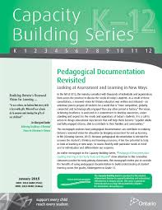
Year Three Inquiry Framework
small group of teachers in five different schools (grades 1-8 represented)
two marker students per class
AfL tools: Observation Tool and Pedagogical Documentation
Purpose:
developing an understanding of what it means to gather data without interpretation
adopting a SWST stance (based on the work of the Student Work Study Teachers and grounded the observations “at the desk of the student”)

Slide 10
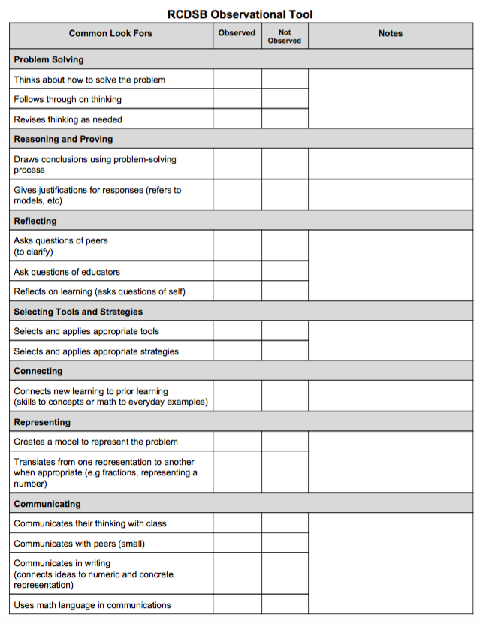
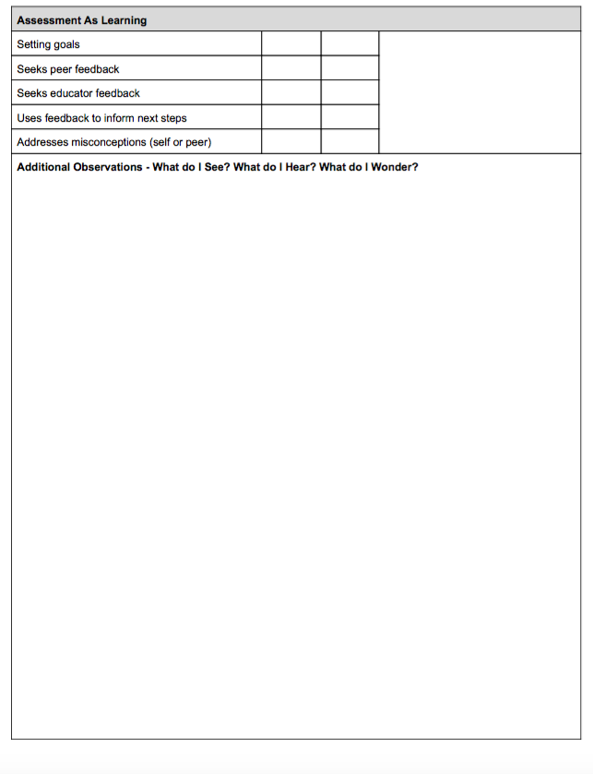
Observational Tool

Slide 11
Learnings and Wonderings
Learnings:
students do not always learn what we think we are teaching
teachers valued the time to learn at the desk of the student
teachers increased their use of observation and conversation
teachers indicated the importance of identifying where a student is at in their understanding and building from this point (asset lens)
Wonderings:
how to sustain and spread this work throughout the system?
how much time is needed to move from professional learning to professional practice?
as we move from professional learning to professional practice, will we see that educators come to regard assessment as an integral part of teaching and learning, not a separate part of instruction?

Slide 12
Catholic DSB of Eastern Ontario
Board Inquiry:
How does co-facilitated collaborative inquiry support the development of teachers’ fluency with assessment and feedback in order to enhance students’ learning in math?
Notes:
Catherine (6-8 min): Describe how AfL has played a role in your DSB’s inquiry—you supporting teachers’ use AfL in the classroom with students OR you using AfL to support teachers’ learning in the project OR something else AfL-related

Slide 13
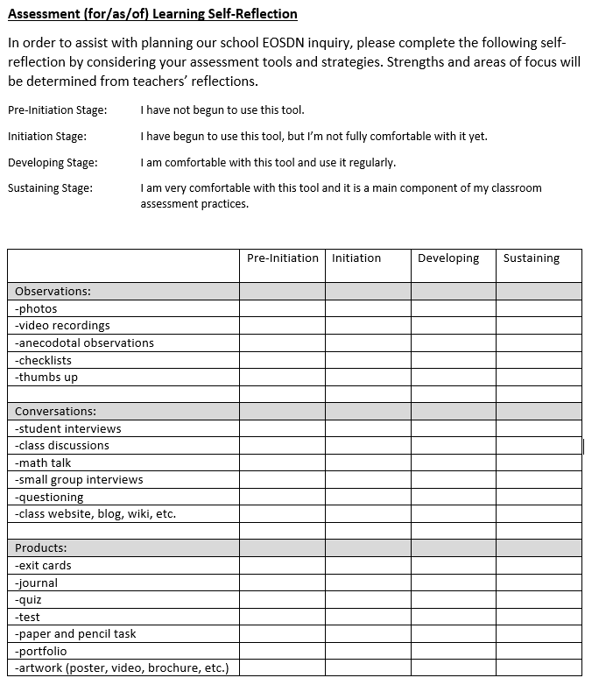
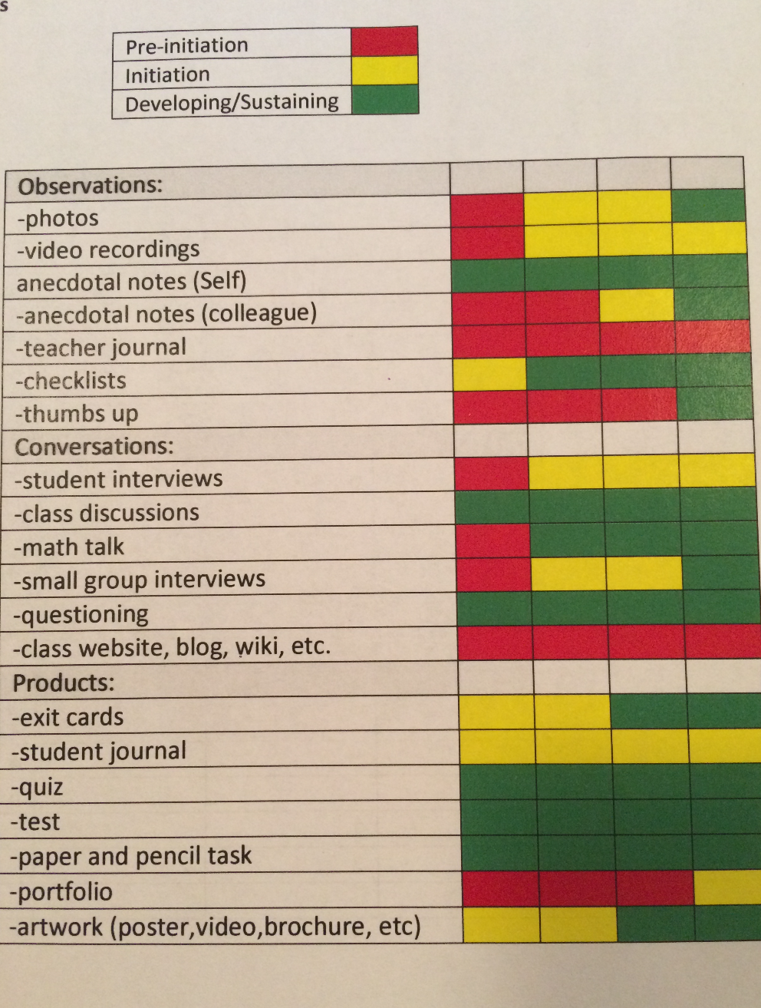
After 3 years how did we land on assessment?
“Our Journey”
Conversations
Assessment
Observations
Products
Notes:
A very brief explanation of how we as an EOSDN team decided to focus on assessment and feedback.

Slide 14
Individual Teacher Inquires Included Exploring…
Photographs
Video (student generated)
Checklists
Exit Cards
Observations
Conferencing / Verbal Feedback
Math Talk
Class Discussions
Student Journals
As the coach, my role varied with each individual inquiry. Each teacher, class and student needed individualized support and each process was very fluid.
Notes:
Go through how I supported in schools (remove the barrier)

Slide 15
Key Findings
Differentiating feedback was important.
Verbal, face to face feedback/assessment was the most effective. (Challenges / Solutions)
Building positive relationships at every level is important.
Assessment actually built relationships.
Mindset was affected; Both student and teacher mindsets improved. By changing just some assessments, teachers began to look for what the students could do and not what they could not do. Teachers began to see the ability in all of their learners and not just their struggles.
Teachers knew their students better, they were able to better predict when students may struggle and attend to it before it negatively affected the student.
Teachers were more likely to deviate from “a plan” to attend to the needs/interests of the class when they used non-traditional assessments.
Notes:
Speak to teachers experiences.

Slide 16
Algonquin Lakeshore Catholic DSB
How does a deeper understanding of the key concepts of proportional reasoning (e.g., fractions, multiplicative thinking, algebraic reasoning) contribute to more effective assessment for learning practices among educators?
Year 1: (Junior)
Why are most students representing their fractional thinking in circles no matter what the context?
How might we build on this representation of fractional quantities in an area model to a deeper understanding of proportional reasoning using a linear model of representation?
Year
Notes:
Vicki (6-8 min): Describe how AfL has played a role in your DSB’s inquiry—you supporting teachers’ use AfL in the classroom with students OR you using AfL to support teachers’ learning in the project OR something else AfL-related

Slide 17
Algonquin Lakeshore Catholic DSB
Year 2: (Primary & Junior)
All students will think multiplicatively in a variety of mathematical situations.
What learning tools and representations build understanding of multiplicative thinking?
What educator moves support students in moving from additive to multiplicative thinking?
How can we start building the foundation for multiplicative thinking in the early years?
Year 3: (Grades 7-10)
All students will think multiplicatively across multiple mathematics strands through a modified lesson study format.
How might implementing a modified lesson study framework cultivate collaborative leadership?
How might a modified lesson study focus on algebraic reasoning support enhanced teaching and learning in math?
Year
Notes:
Vicki (6-8 min): Describe how AfL has played a role in your DSB’s inquiry—you supporting teachers’ use AfL in the classroom with students OR you using AfL to support teachers’ learning in the project OR something else AfL-related

Slide 18
EOSDN Math Project Guiding Questions Moving from Year 2 into Year 3
Renfrew County Catholic DSB
How do we increase teacher fluency and independence using data to inform their practice?
How do we spread the pockets of vibrant math culture in schools through strategic teacher leadership and administrator support?
How do we leverage distributed leadership in order to systematically impact teacher practice, student learning and achievement in mathematics
Notes:
Tracy

Slide 19
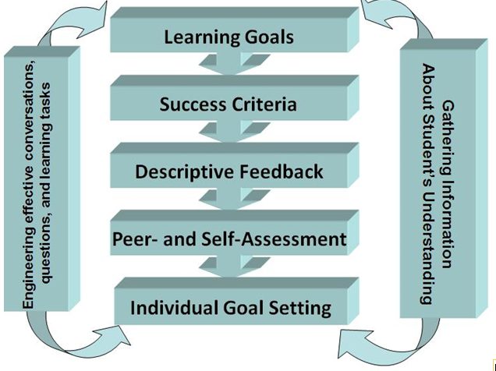

Slide 20
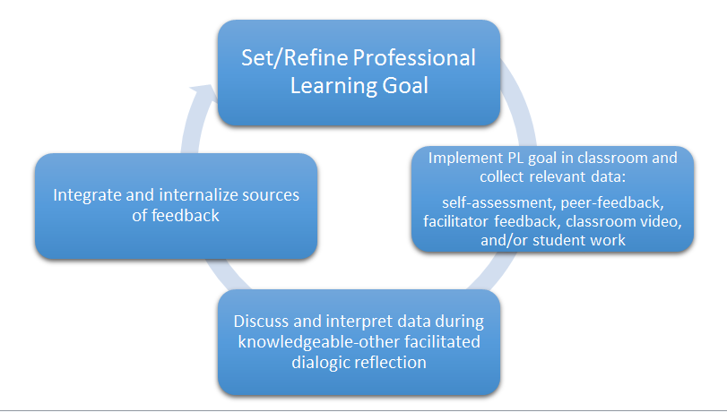
Feedback-driven Professional Learning Model
Notes:
Tracy

Slide 21
Integrating and Internalizing Sources of Feedback
Teacher Questioning Techniques
Student Talk Moves
Learning Goals and Success Criteria
Lesson Structure
Use of tools (manipulatives/technology)
Consolidation Structures/Questions/Techniques (Use of the 5 Practices)
DI Strategies
Responding to Student Need over time (marker students) / Intervention Materials
Facilitator Moves
Notes:
Tracy

Slide 22
Thank you
and questions!
Notes:
Approx 10 minutes for questions

